Slide 5
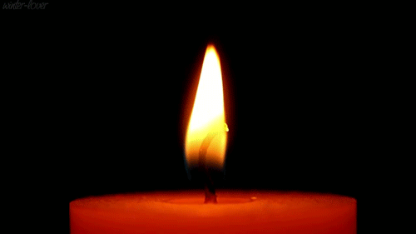
Lighting the christ candle

Slide 7
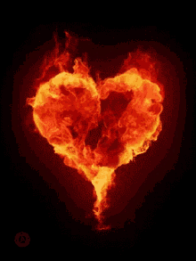
The Lord Be With You
And, Also With You

Slide 8
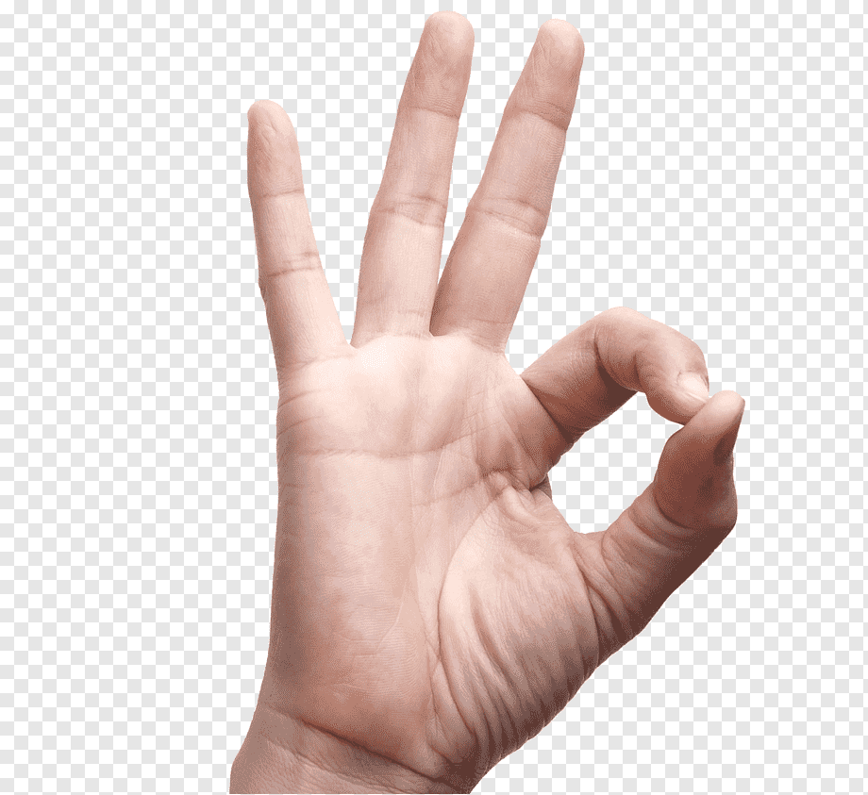
Sign of Peace

Slide 10
Psalm 20
1 May the LORD answer you
when you are in distress; may the name of the God of
Jacob protect you.
2 May He send you help
from the sanctuary and grant you
support from Zion.

Slide 11
3 May He remember
all your sacrifices and accept your burnt offerings.
4 May He give you
the desire of your heart and make all your plans
succeed

Slide 12
5 We will shout for joy
when you are victorious and will lift up our banners
in the name of our God. May the LORD
grant all your requests.
6 Now I know that the LORD
saves His anointed;
He answers them from His Holy heaven
with the saving power of His right hand

Slide 13
7 Some trust in chariots
and some in horses, but we trust in the name
of the LORD our God.
8 They are brought to
their knees and fall, but we rise up and stand firm.

Slide 14
9 O LORD, save the Us!
Answer us when we call!

Slide 16
God merciful and righteous is,
A gracious Lord is He;
What shall I render to the Lord
For all His gifts to me?
1/5

Slide 17
I’ll lift with joy salvation’s cup,
On God’s name will I call;
The vow I promised I will pay
Now in the sight of all.
2/5

Slide 18
The death of every saint of God
Is precious in His sight.
I am Your slave, Your handmaid’s son
Set free, Lord, by Your might.
3/5

Slide 19
Thanksgiving I will offer You,
on God’s name will I call.
I’ll pay my vows unto the Lord
Now in the sight of all.
4/5

Slide 20
Within the courts of God’s own house,
Within His holy place,
O city of Jerusalem
Unto the Lord Give praise.
5/5
Neil Dougall 1776-1862

Slide 23
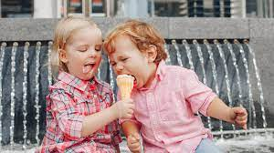

Slide 24
Books??
Or Movies
Anniversary?
Birthday?
Births?
Good News?

Slide 25
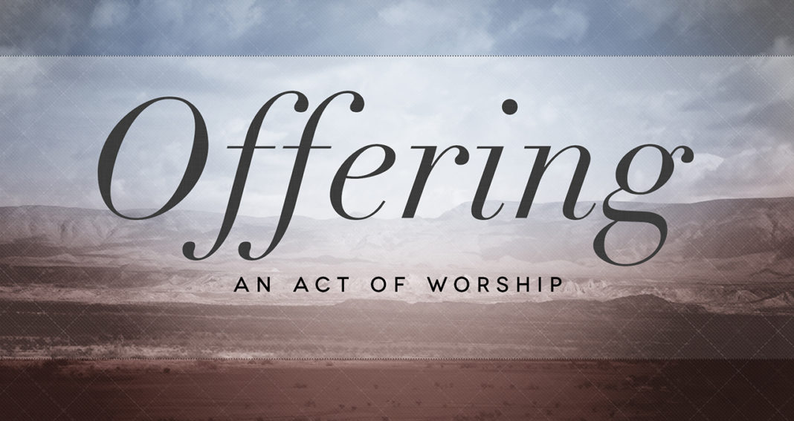

Slide 27
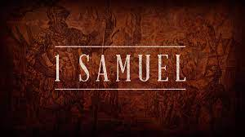

Slide 28
1 Samuel 15:34-16:13
³⁴ Then Samuel left for Ramah, but Saul went up to his home in Gibeah of Saul. ³⁵ Until the day Samuel died, he did not go to see Saul again, though Samuel mourned for him.
And the Lord regretted that he had made Saul king over Israel.

Slide 29
Samuel Anoints David
16 The Lord said to Samuel, “How long will you mourn for Saul, since I have rejected him as king over Israel? Fill your horn with oil and be on your way; I am sending you to Jesse of Bethlehem.
I have chosen one of his sons to be king.”
² But Samuel said, “How can I go? If Saul hears about it, he will kill me.” The Lord said,
“Take a heifer with you and say,
‘I have come to sacrifice to the Lord.’

Slide 30
³ Invite Jesse to the sacrifice, and I will show you what to do. You are to anoint for me the one I indicate.” ⁴ Samuel did what the Lord said.
When he arrived at Bethlehem, the elders of the town trembled when they met him. They asked,
“Do you come in peace?” ⁵ Samuel replied,
“Yes, in peace; I have come to sacrifice to the Lord.
Consecrate yourselves and come to the sacrifice with me.” Then he consecrated Jesse and his sons
and invited them to the sacrifice.

Slide 31
⁶ When they arrived, Samuel saw Eliab and thought, “Surely the Lord’s anointed stands here before the Lord.”⁷ But the Lord said to Samuel,
“Do not consider his appearance or his height,
for I have rejected him. The Lord does not look at the things people look at. People look at the outward appearance, but the Lord looks at the heart.”
⁸ Then Jesse called Abinadab and had him pass in front of Samuel. But Samuel said,
“The Lord has not chosen this one either.”

Slide 32
⁹ Jesse then had Shammah pass by, but Samuel said, “Nor has the Lord chosen this one.” ¹⁰ Jesse had seven of his sons pass before Samuel, but Samuel said to him, “The Lord has not chosen these.” ¹¹ So he asked Jesse, “Are these all the sons you have?” “There is still the youngest,” Jesse answered. “He is tending the sheep.” Samuel said, “Send for him; we will not sit down until he arrives.”

Slide 33
¹² So he sent for him and had him brought in.
He was glowing with health and had a fine appearance and handsome features.
Then the Lord said, “Rise and anoint him;
this is the one.” ¹³ So Samuel took the horn of oil
and anointed him in the presence of his brothers,
and from that day on the Spirit of the Lord came powerfully upon David. Samuel then went to Ramah.

Slide 35
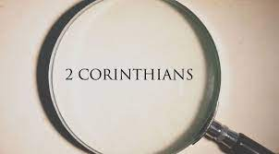

Slide 36
⁶ Therefore we are always confident and know that as long as we are at home in the body we are away from the Lord. ⁷ For we live by faith, not by sight. ⁸ We are confident, I say, and would prefer to be away from the body and at home with the Lord.
⁹ So we make it our goal to please him, whether we are at home in the body or away from it. ¹⁰ For we must all appear before the judgment seat of Christ, so that each of us may receive what is due us for the things done while in the body, whether good or bad.

Slide 37
¹⁶ So from now on we regard no one from a worldly point of view. Though we once regarded Christ in this way, we do so no longer. ¹⁷ Therefore,
if anyone is in Christ, the new creation has come:
The old has gone, the new is here!
¹⁸ All this is from God, who reconciled us to himself through Christ and gave us the ministry of reconciliation:

Slide 38
¹⁹ that God was reconciling the world to himself in Christ, not counting people’s sins against them. And he has committed to us the message of reconciliation. ²⁰ We are therefore Christ’s ambassadors, as though God were making his appeal through us. We implore you on Christ’s behalf: Be reconciled to God. ²¹ God made him who had no sin to be sin for us, so that in him we might become the righteousness of God.

Slide 40
Faith will not grow from words alone,
From proofs provided, scripture known
Our faith must feel its way about,
And live with question-marks and doubt.
1/4

Slide 41
The pattern Jesus showed, we share:
Life comes through death, hope through despair:
God is made known in brokenness,
And faith feeds on God’s emptiness.
2/4

Slide 42
The church still tells how Jesus came
Through death to glorious life again
The strangest story! Yet, maybe,
Our faith will thrive on mystery.
3/4

Slide 43
Faith takes the little that we know,
And calls for hope, and tells us: Go!
Love and take courage, come what may;
Christ will be with us on the way.
4/4

Slide 44
⁶ Therefore we are always confident and know that as long as we are at home in the body we are away from the Lord. Please be in no hurry, there are still amazing things to be done and see and enjoy ⁷ For we live, walk, by faith, not by sight.
1 Cor 13:12, I see in a mirror dimly…
⁸ We are confident, I say, and would prefer to be away from the body and at home with the Lord.

Slide 45
⁹ So we make it our goal, aim, to please him,
whether we are at home in the body or away from it, no matter what, the more we aspire to please the more we are likely to do so. ¹⁰ For we must all appear before the judgment seat of Christ, so that each of us may receive what is due us for the things done while in the body, whether good or bad.
The Cracked Pot Story.

Slide 46
¹⁶ So from now on we regard NO ONE from a worldly point of view. Though we once regarded Christ in this way, we do so no longer. ¹⁷ Therefore,
if anyone is in Christ, the NEW CREATION has come: THE OLD HAS GONE, THE NEW IS HERE! NEW ATTITUDE ¹⁸ All this is from God, who reconciled us to himself through Christ and gave us the ministry of reconciliation what do we think of this?:

Slide 47
¹⁹ that God was reconciling the world to himself in Christ, not counting people’s sins against them. And he has committed to US THE MESSAGE OF RECONCILIATION. ²⁰ WE ARE THEREFORE CHRIST’S AMBASSADORS, as though God were making his appeal through us. We implore you on Christ’s behalf: Be reconciled to God. ²¹ God made him who had no sin to be sin for us, so that in him we might become the righteousness of God.

Slide 49
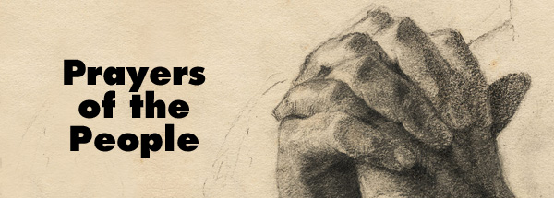

Slide 50
Our Father in heaven,
hallowed be Your name,
Your kingdom come,
Your will be done
On earth as in heaven.
Give us today our daily bread.

Slide 51
And forgive us our sins,
As we forgive those
who sin against us.
Save us from the time of trial,
And deliver us from evil.
For the kingdom, the power
and the glory are Yours,
Now and forever. Amen.

Slide 53
This is the day of new beginnings,
Time to remember, and move on,
Time to believe what love is bringing,
Laying to rest the pain that has gone.
1/4

Slide 54
For by the life and death of Jesus,
God’s mighty spirit, now as then,
Can make for us a world of difference
As faith and hope are born again.
2/4

Slide 55
Then let us, with the spirit’s daring
Step from the past, and leave behind
Our disappointment, guilt and grieving,
Seeking new paths, and sure to find.
3/4

Slide 56
Christ is alive, and goes before us
To show and share what love can do
This is a day of new beginnings
Our God is making all things new.
4/4
Carlton R. Young 1926 -

Slide 58
Good Morning
Have a
good week

Slide 59
